Slide 1
Xo Skin Web Application
Project plan review – Phase 1

Slide 2
SCHEDULE highlights
Product launch DATE can be from Saturday 10/30/2021 onward
Xo skin WEB APPLICATION WILL BE DEPLOYED TO PRODUCTION ON FRIDAY OCTOBER 29 2021
SOFTWARE DEVELOPMENT WORKLOAD HAS BEEN DIVIDED INTO 9, 3 TO 10 DAY SPRINTS
SPRINT 1 COMMENCED ON 7/9/2021 AND ENDED ON 7/22/2021
THERE IS NO QA\TESTING UNTIL THE END OF SPRINT 4 (8/18/2021)
AFTER THAT, FROM SPRINTS 4 TO 9 THERE IS QA\TESTING AFTER EACH SPRINT IS DONE
AFTER QA\TESTING FOR SPRINT 9 THERE IS GENERAL SYSTEMS QA\TESTING

Slide 3
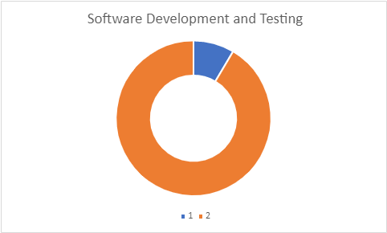
HOURS INVESTED directly ON SOFTWARE PER type of work
TIGHT SCHEDULE: BOTH SOFTWARE DEVELOPMENT AND QA/TESTING NEEDS TO BE VERY focused and EFFICIENT.
SOFTWARE DEVELOPMENT: 5,500 MAN-HOURS
SOFTWARE TESTING and fixing: 528 man-hours
Development/Testing ratio: 100/10.41 (1OO/15-100/35 considered normal, ours is slightly low, Will have to make-up with high team expertise.)
Total direct SW Development and testing: 6,028 M.-H.
Software developer will be in constant contact with QA/tester during testing period to solve any problems at the moment, if they're found.

Slide 4
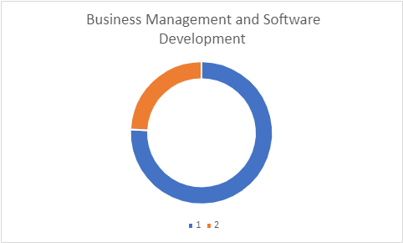
Hours invested in business management, BUSINESS RESEARCH, Tech Research
1. Xo skin business Management, Business Research, tech research: ~18,800 MAN-HOURS
2. DIRECT Software development: 6,028 MAN-HOURS
Total project man-hours: ~24,800 man-hours

Slide 5
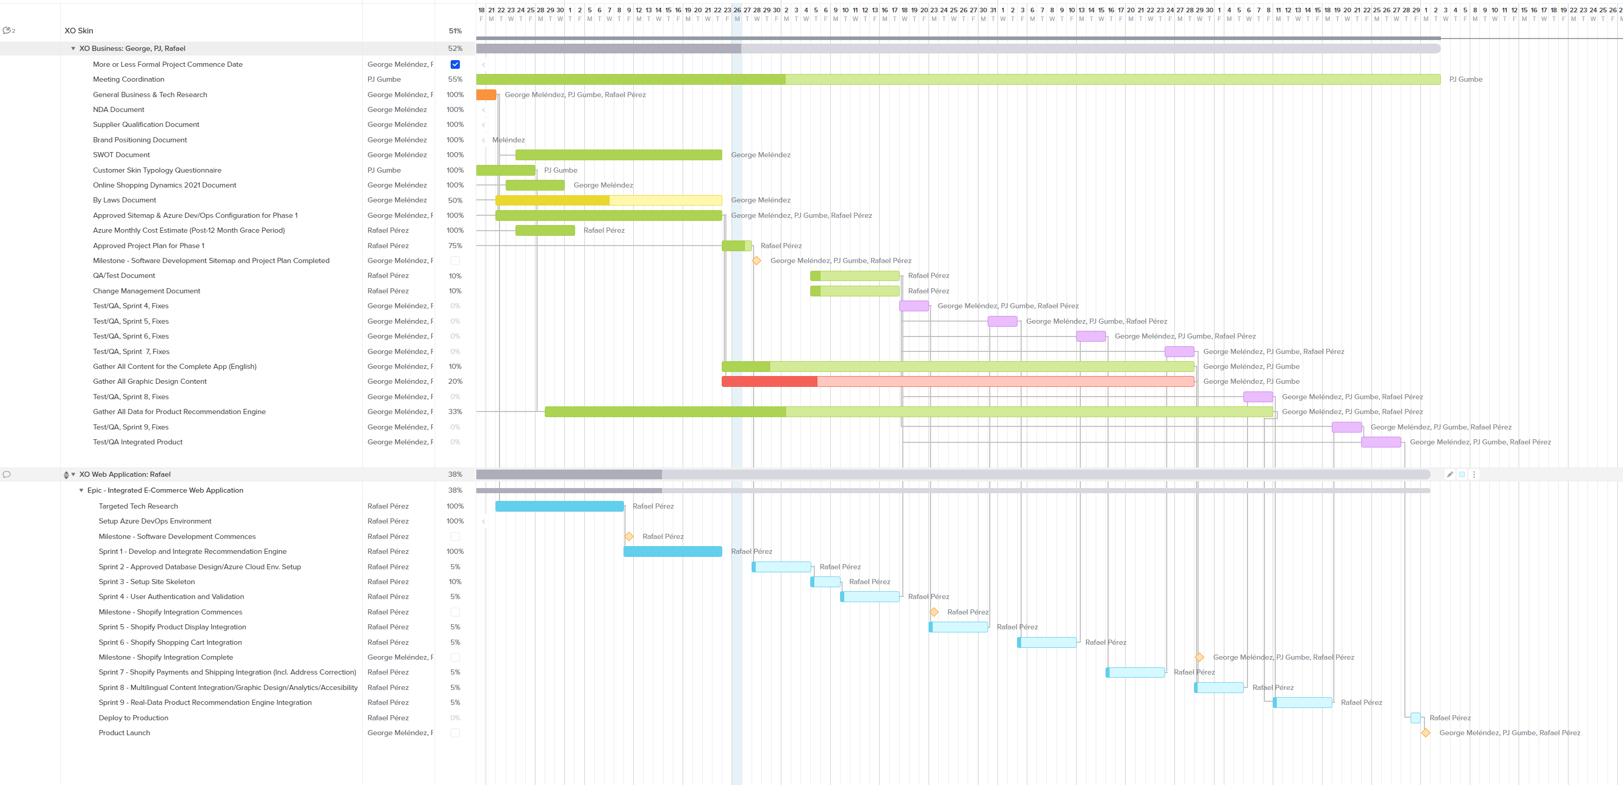
Plan review and approval at team Gantt

Slide 6
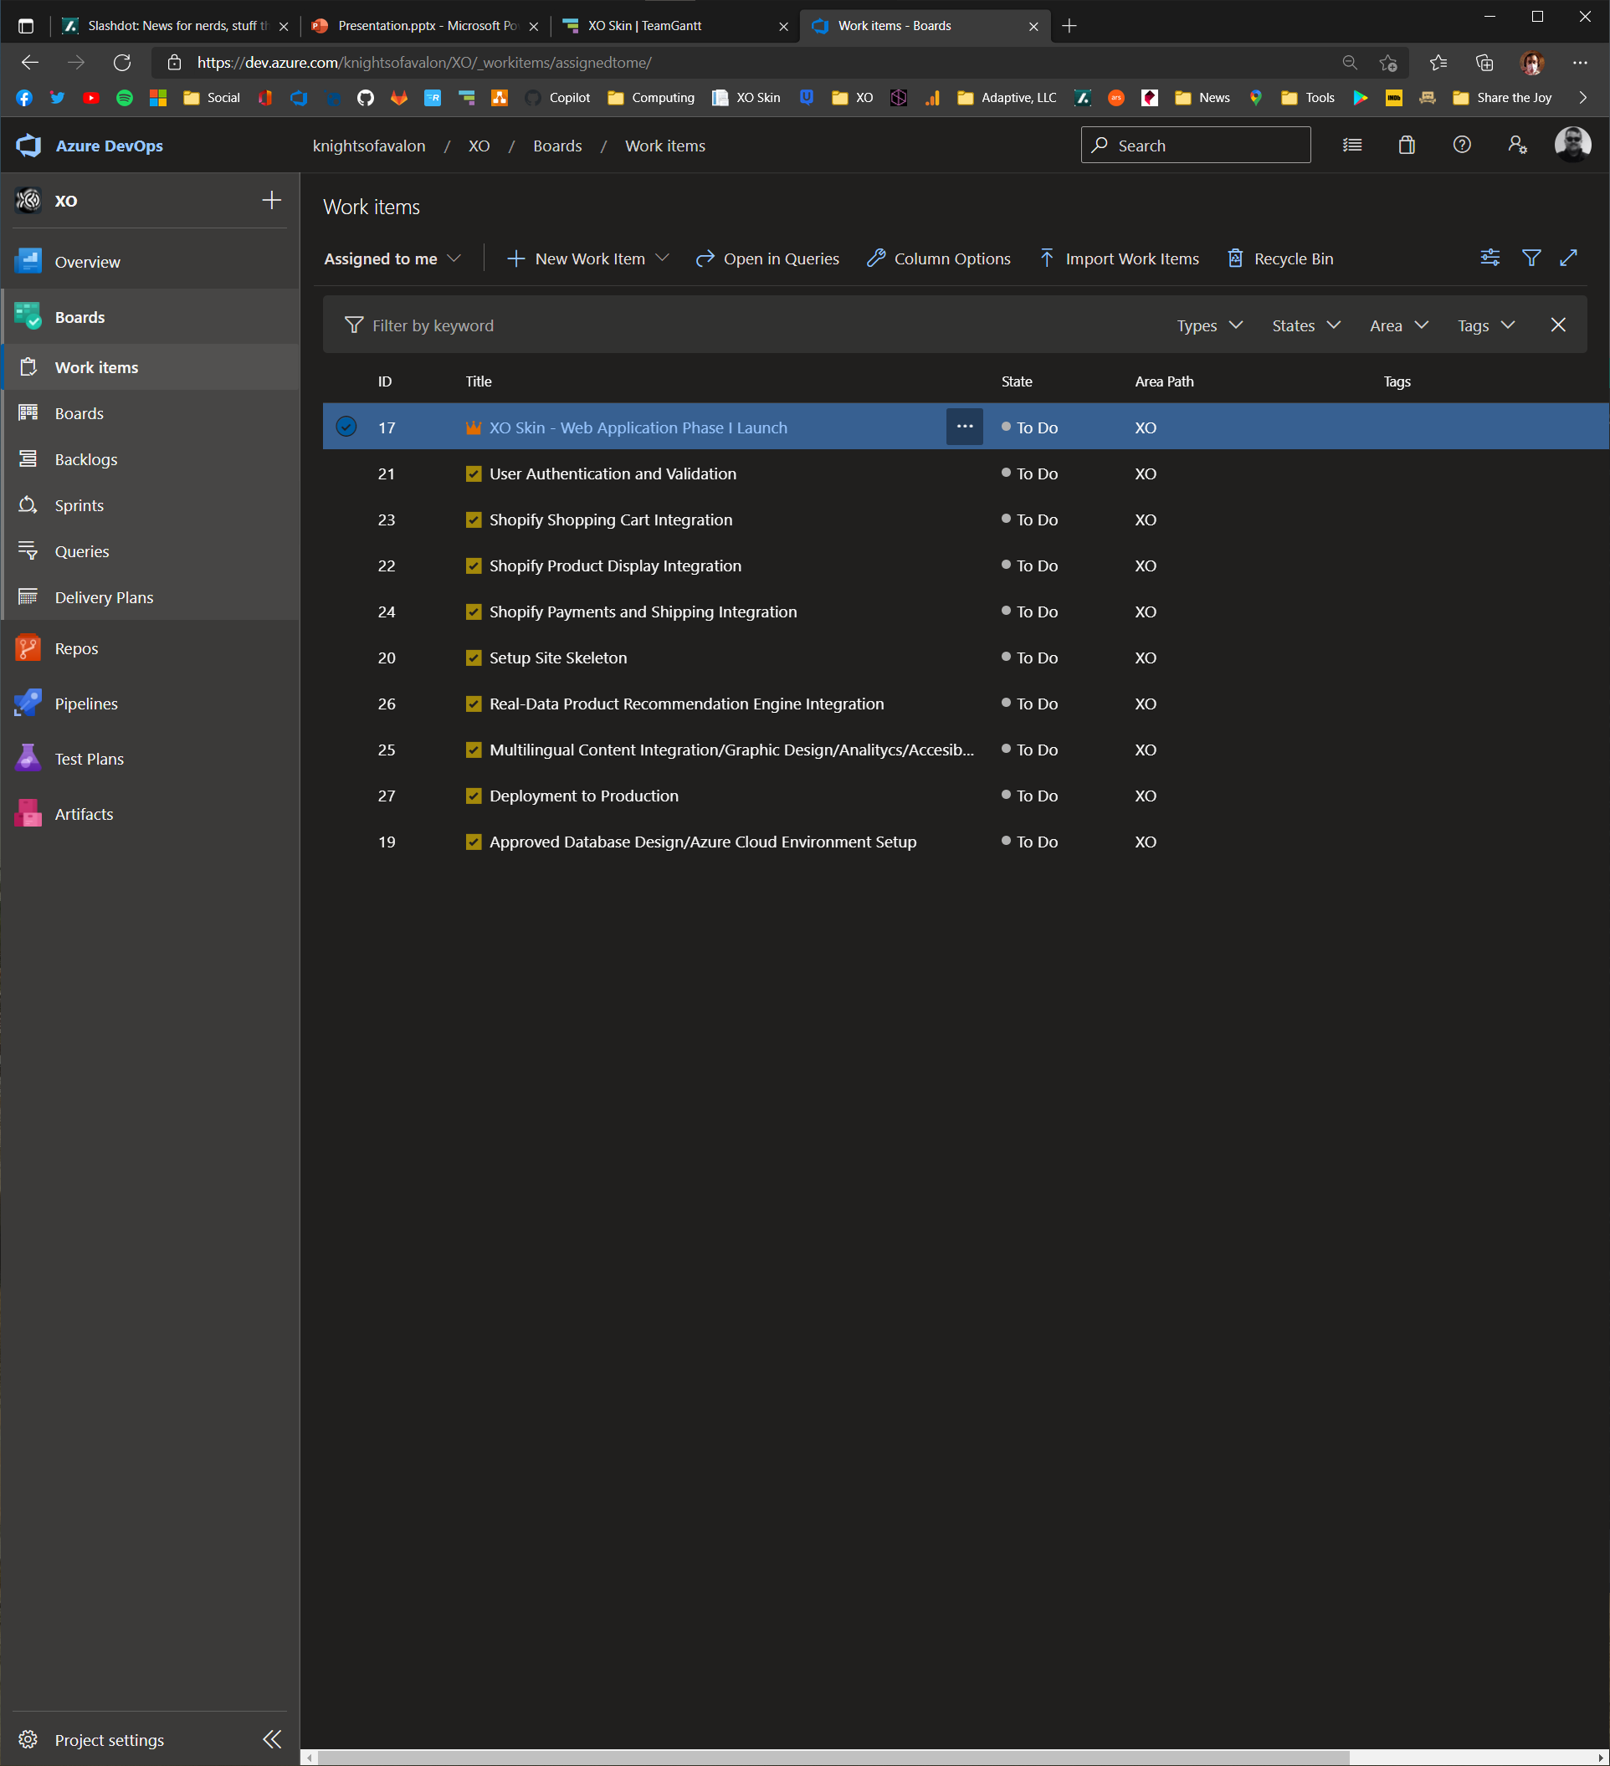
On Azure Dev/ops Boards

Slide 7
ON AZURE DEV/OPS BOARDS
Helps Keep track of software development lifecycle (SDLC)
Keeps track of bugs (I.e. "issues") as and if they're found and corrected during QA/test/Fix efforts
Uses hierarchical structuring to model parent-offspring relationships (e.g. an issue has a parent which is the task (programming task) it's related to, the task has two parents: 1. the sprint it's in, 2. the epic it belongs to
A sprint is a fixed amount of time into which you add programming tasks. They're usually 5-10 days long and each produce testable artifacts
A Task is a unit of programming (e.g. "User authentication/authorization")
An epic contains one or more tasks (e.g. XO SKIN Web Application Phase I)

Slide 8
ON AZURE DEV/OPS BOARDS
A NEW "WORK ITEM" CAN BE EITHER AN "EPIC", A "TASK", OR AN "ISSUE" (I.e. BUG.) SPRINTS ARE DEFINED AT PROJECT START
AZURE DEV/OPS BOARDS (Have Epics, Sprints, Tasks and Issues for a Project)
Epic A (Has Sprints, Tasks and Issues)
Sprint N (Timed, Has Tasks)
Sprint 3 (Timed, has Tasks)
Sprint M (Timed, has Tasks)
Programming Task N (Can Have Issues)
Testing Task M (Can Have Issues)
Programming Task C (Has Issues)
Testing Task D (Has Issues)
Programming Task M (Can Have Issues)
New Workitem: Issue C1
New Workitem: Issue C2
New Workitem: Issue D1

Slide 9
Azure dev/ops boards
Best learned by practicing (it's hard to break things, and easy to fix them) and also reading/viewing the content found in the product's document page: Azure Boards documentation | Microsoft Docs https://docs.microsoft.com/en-us/azure/devops/boards/?view=azure-devops

Slide 10

Questions?
Permission to execute the Taskmaster Protocol?

